Slide 1
GOOGLE MEET PRESENTATIONS
Giving a presentation using:
Chrome
or
Firefox

Slide 2
If you want to set up a streaming video, a Google slide presentation or another internet site, here are the directions for using these browsers.
Included in this PowerPoint are directions for Chrome and Firefox. Both of these browsers are very similar for sharing internet sites, PowerPoints, and documents.
Safari is not very easy to use for presentations in Google Meet. That is the reason why directions for showing a presentation in Google Meet using Safari, are not included in this PowerPoint.

Slide 3
PRESENTING A STREAMING VIDEO OR AN INTERNET SITE using CHROME. 1. Open the internet site you want to share with your group. 2. Then click on the tab to go back to your meeting.

Slide 4
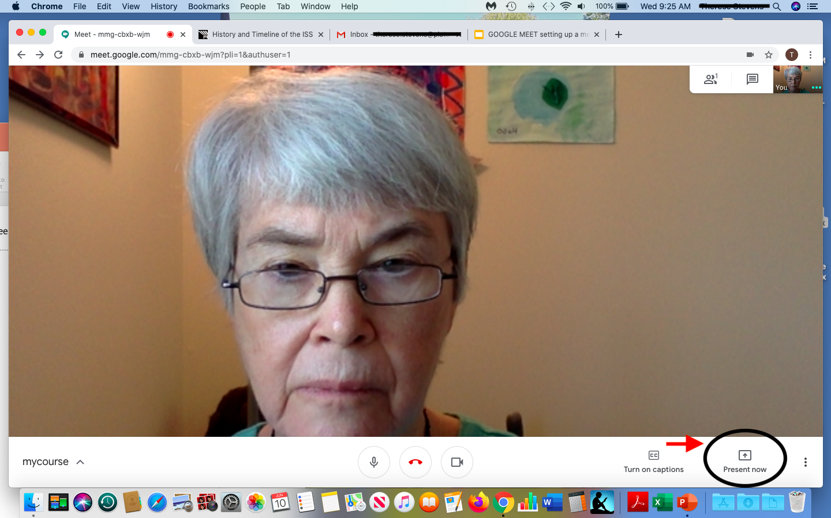
In the lower right hand corner, click on PRESENT NOW.

Slide 5
You will see three choices for presentations. Click on Chrome Tab.

Slide 6
1. Click on the name of your streaming video, slides or internet site that appears in the box. 2. Then click on the word: SHARE

Slide 7
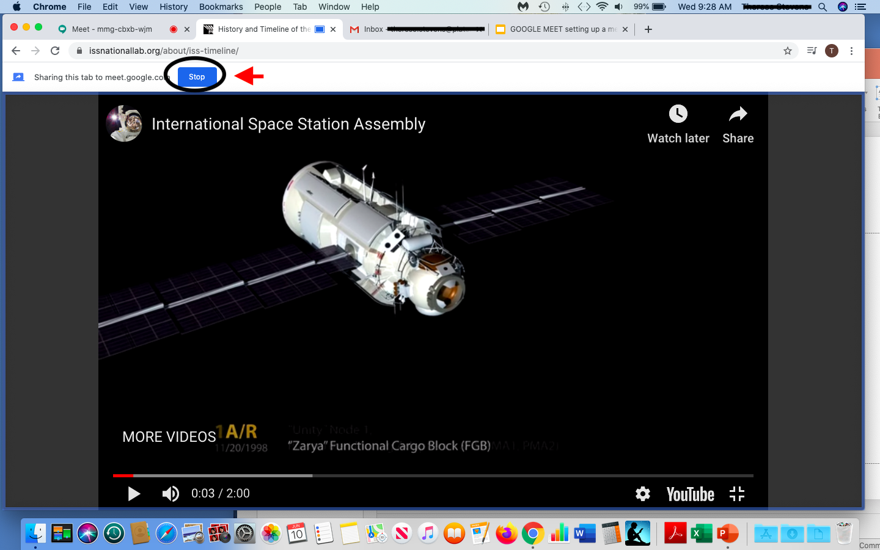
1. Your presentation is now ready to share to all your participants. 2. When you are done sharing, Click STOP SHARING at the top of the Meet screen.

Slide 8
1. Click on the tab of your meeting at the top of your screen and you will be back to seeing all your participants.

Slide 9
Firefox directions
The difference between Chrome and Firefox for presenting a streaming video, or another internet site, is the number of choices one has for presenting.
In Chrome there are 3 choices to choose from for presenting:
in Firefox, there are 2 choices for presenting.
The following slides will show the difference.
9

Slide 10
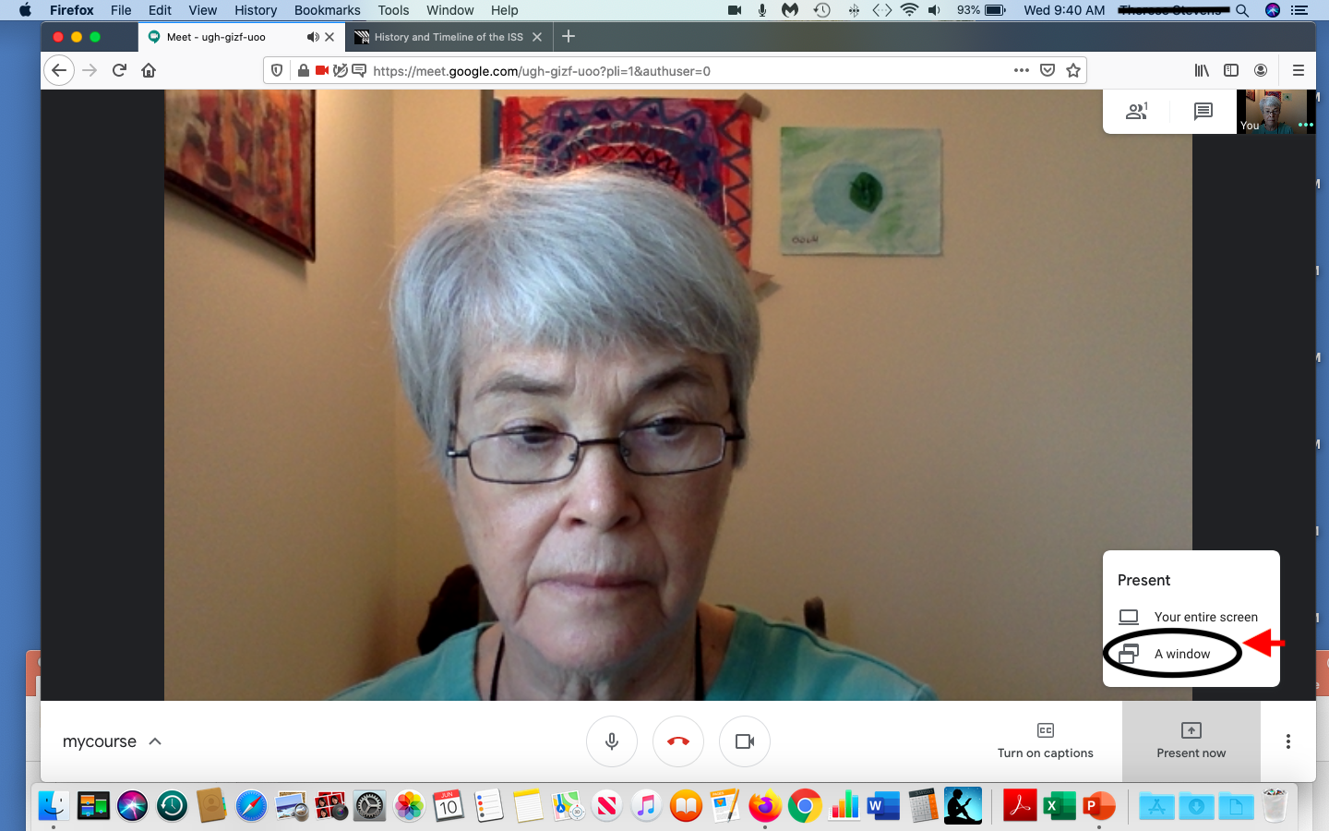
FIREFOX DIRECTIONS FOR PRESENTING A STREAMING VIDEO OR INTERNET SITE. In Firefox, you will have only two choices in PRESENT NOW. Click on A WINDOW.

Slide 11
Drop down Menu: click on the Select window or screen.

Slide 12
Click on ENTIRE SCREEN.

Slide 13
1. Click ALLOW. 2. Then click on the tab you want to present.

Slide 14
Now you can show your streaming video to your participants. You will not see a small window of yourself, but you participants will be able to see you. When you finish, close out your video and click on your google meet to return to your meeting.

Slide 15
You will return to your original screen. Click on STOP PRESENTING.

Slide 16
Showing a PowerPoint or sharing a document
The directions for showing a PowerPoint or sharing a document are the same in both Chrome and Firefox.
The following slides will show how to present a PowerPoint in Chrome.
16

Slide 17
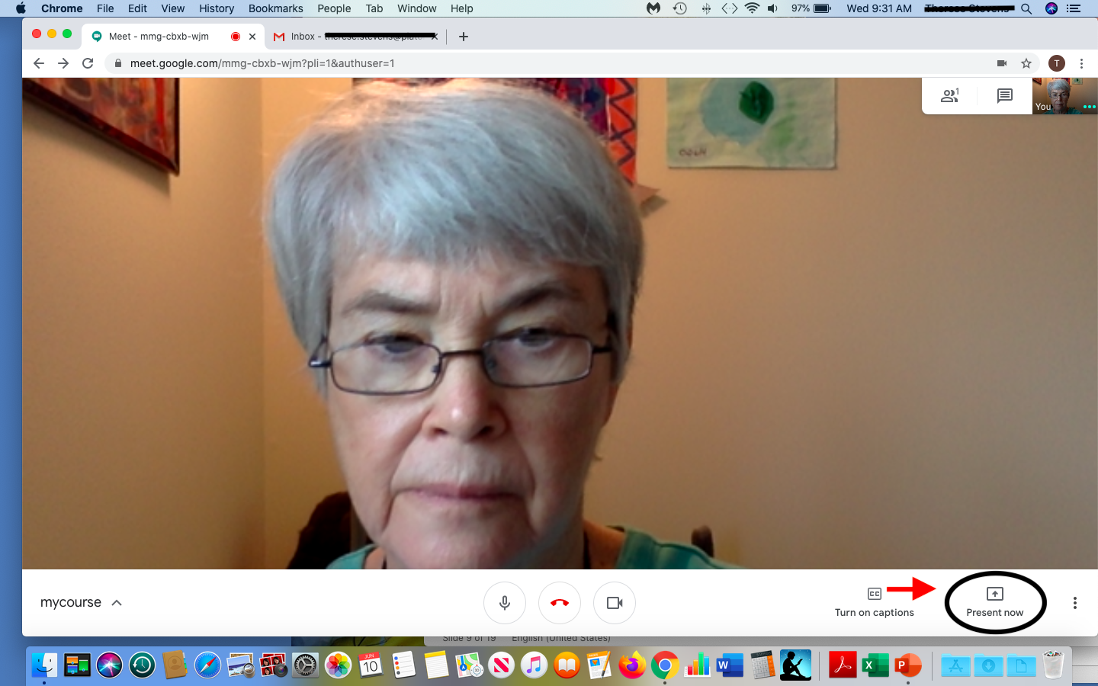
To show a PowerPoint in CHROME (or FIREFOX) follow these directions: Click on PRESENT NOW on the white bar in the lower right hand corner of the Meet screen.

Slide 18
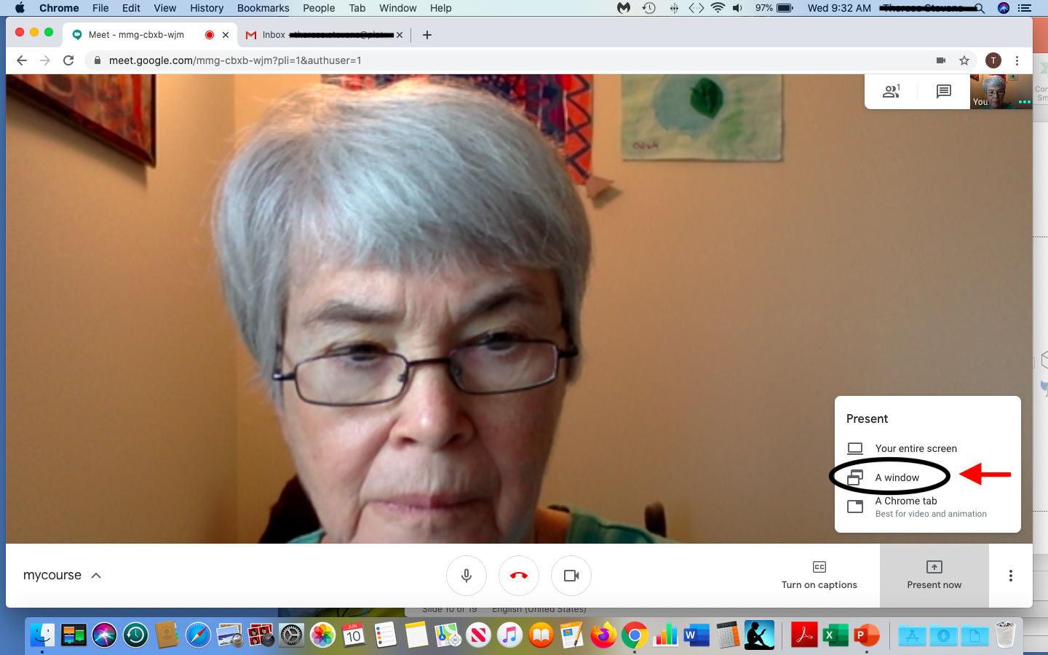
Click on : A WINDOW.

Slide 19
1. Click on the picture of your PowerPoint you would like to share in the box. 2. Then click SHARE.

Slide 20
Your PowerPoint will now show up on your screen. Your participants will also see a small window of you on their screens. When you are finished, click on the words: STOP SHARING at the bottom of the Meet Screen. You will go back to your original meeting screen where you will see your participants.

Slide 21
In FIREFOX YOU WILL RETURN TO YOUR ORIGINAL SCREEN Click on STOP PRESENTING and you will see your participants again.

